Slide 1
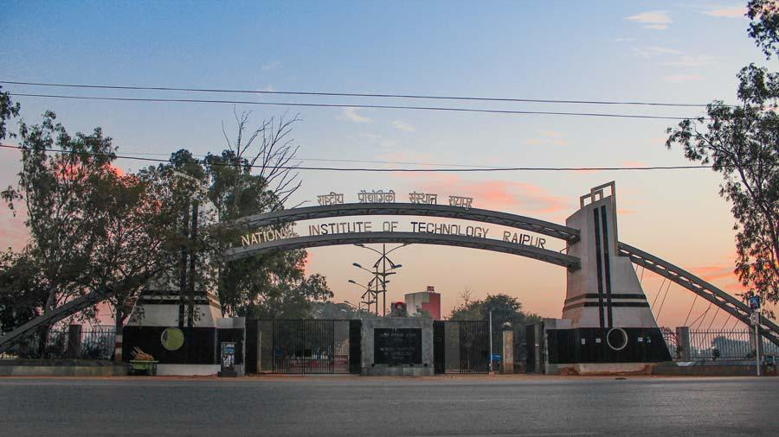
Elephant Alert & Tracking System
Project By
Mihir Kumar Singh (15115906)
Ishaan Singhal (15115904)
Guided By :-Dr. Dilip Singh Sisodia

Slide 2
Agenda
Problem Statement
Solution to the Problem
Technology Stack
Conclusions
Way Forward

Slide 3
Problem Statement
Prevent Human and Elephant conflict by alerting people and tracking the movement of elephant herds.

Slide 4
Reason for making the interface.
In corridors of northern Chhattisgarh, elephants and people have to increasingly share land and resources, leading to frequent and often fatal conflict resulting in death and harm to lives and resources. How can we resolve this problem?
We can prevent this conflict by alerting the people through SMS and making them aware about the paths followed by the herds of elephant and thus avoiding conflicts.
Data of path followed by elephants can be used in research and study purposes to know why they are following that particular path.

Slide 5
Solution to Problem
Provided a web interface through which competent authority can generate alert via SMS once it is confirmed that a herd of elephant is present in their area.
Users can also see the path followed by the herds of elephants using the web interface.

Slide 6
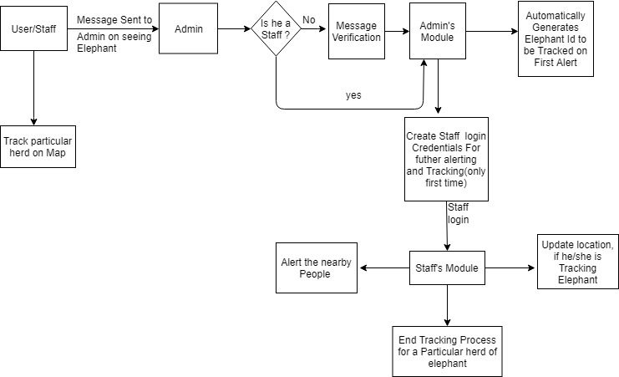
WORKING MODEL

Slide 7
Types of Users
Naive Users →They are the local people of that region.
Admin → She/he is the forest officer in charge.
Staff → She/he is the employee appointed by admin whose task is to track the herd of elephant and generate alert.(forest department officials etc)

Slide 8
Naive User
Role
Sends message to Admin if he/she sees herd of elephant in his/her region.
Facilities
They can track the movement of herds of elephants on map through our module.
They are alerted via SMS if there is any herd of elephant in his/her region.

Slide 9
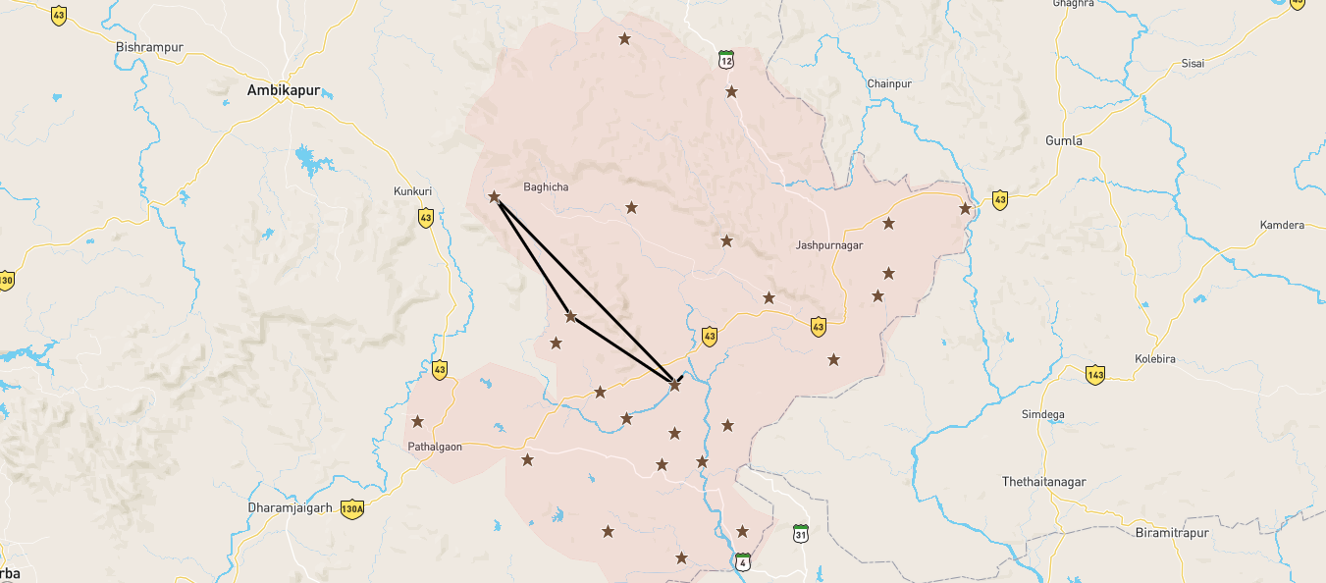
Naive User
Map showing path followed by particular herd of elephant .

Slide 10
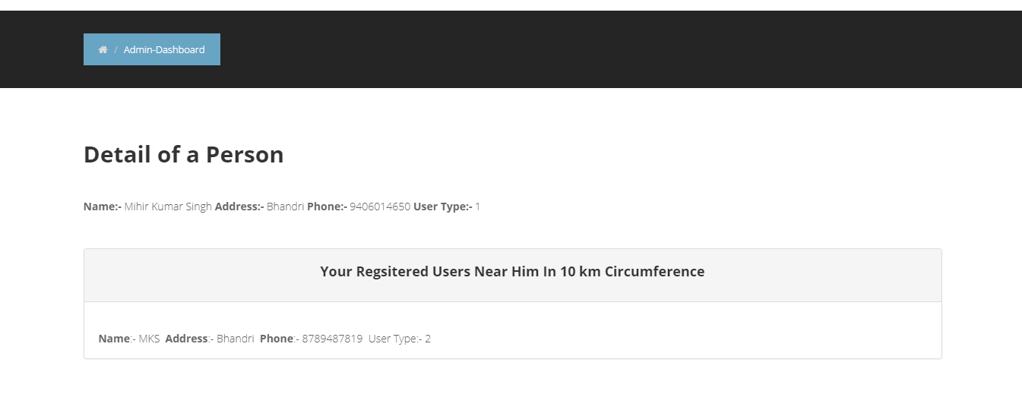
Admin
Role
Finding the detail of person who sent the message.

Slide 11
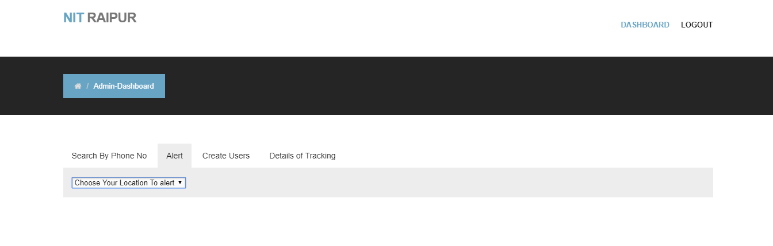
Admin
Alerting the particular region via sms for the very first time(on verification) and simultaneously generating elephant id to be tracked by staff.

Slide 12
Algorithm to find the circumference of area to be alerted.
Given a start point (latitude ,longitude) , initial bearing, and distance, this will calculate the destination point.
Formula:
φ2 = asin( sin φ1 ⋅ cos δ + cos φ1 ⋅ sin δ ⋅ cos θ )
λ2 = λ1 + atan2( sin θ ⋅ sin δ ⋅ cos φ1, cos δ − sin φ1 ⋅ sin φ2 )
where φ is latitude, λ is longitude, θ is the bearing (clockwise from north), δ is the angular distance d/R; d being the distance travelled, R the earth’s radius

Slide 13

Continued..
Thus four points are found at the given distance from the central point.
And , then the number of people within the four points is found out using BETWEEN SQL query on our database.
Desired Region

Slide 14
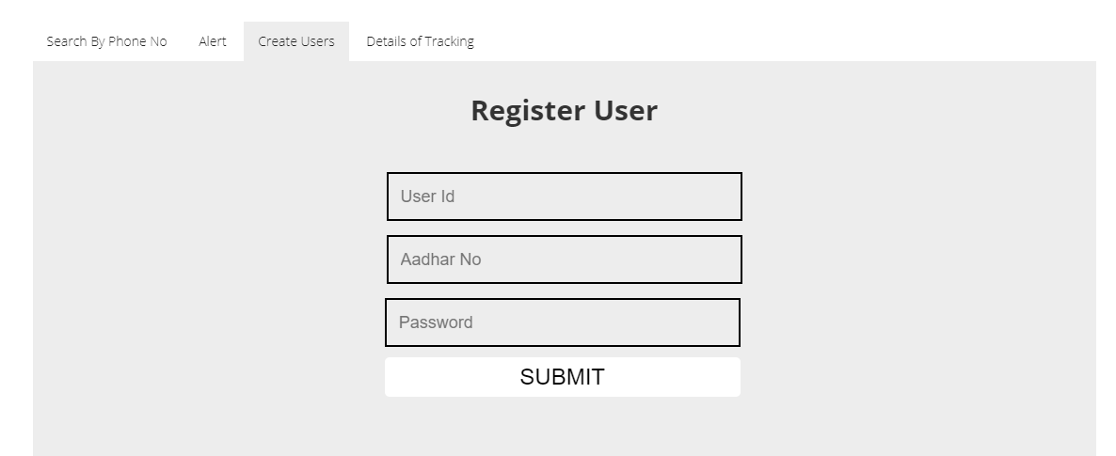
Admin
Creating staff login credentials

Slide 15
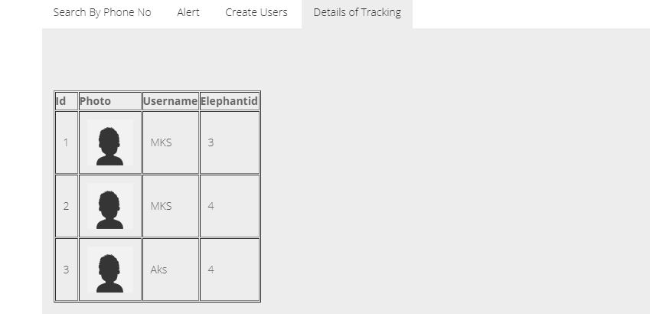
Admin
Facilities
She/he can see which staff is following a particular herd of elephant.

Slide 16
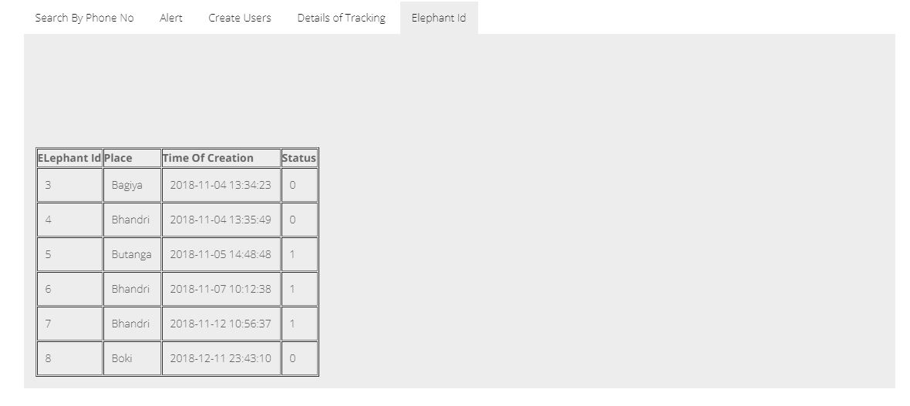
Admin
Facilities
He/she can see which elephant id has been created and is the status of its tracking.

Slide 17
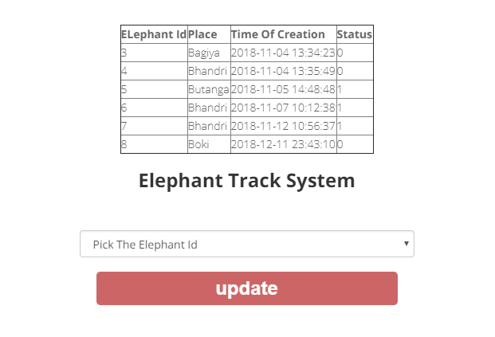
Staff
Role
Track the herd of elephant and update their location by simply selecting their id and clicking update button provided in their dashboard.

Slide 18

Staff
She/he will alert the nearby region by using our module.
Once alert is generated ,SMS is sent to all the residents of that region.

Slide 19
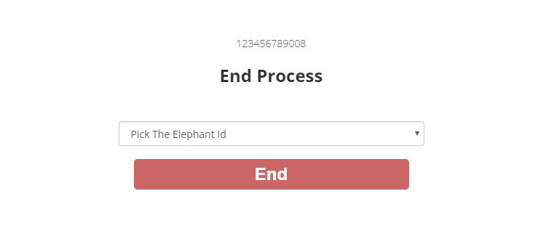
Staff
If Staff wants to end the tracking process for particular herd of elephants , she/he can do so by clicking the end button provided in our module.

Slide 20
Technology Stack used.
Html
CSS
JavaScript
Ajax
Php
SQL
Mapbox API

Slide 21
Conclusion
We have successfully built a module for alerting the people about the herds of elephant and plotting the real time path on map. The proposed module simultaneously fulfils the goal of protecting the resources and avoiding the conflicts between human and elephant.
Using this module we can reduce the Human Elephant conflict and save life and resources by awaring and alerting people.

Slide 22
Way Forward
Further Enhancements will include:
Detecting image of elephant from a set of images and alerting the admin.
Detecting the sound of herds of elephant using deep learning model.
Detecting the distance of herds of elephants from a point using their sound intensity.
Making the interface even more user friendly.

Slide 23
References
[1] https://www.w3schools.com/html/
[2] https://developer.mozilla.org/bm/docs/Web/JavaScript/Guide
[3] https://www.w3schools.com/css/
[4] https://www.w3schools.com/sql/
[5] http://php.net/manual/en/index.php
[6]http://www.movable-type.co.uk/scripts/latlong.html

Slide 24
Thank You

